Slide 1

LegoLogic
Juan Guevara, Miguel Leon, Jenna Vincent

Slide 2

What is TAP?
The Technology Ambassador Program (TAP) is a student-led initiative where participants create workshops to teach others about various topics in Information Technology, such as programming and cybersecurity.
The goal of a TAP project is to get people interested in IT by providing engaging, accessible educational experiences that introduce new skills and concepts to a broad audience.
Notes:
Juan

Slide 3

Goals
This study is geared towards individuals with no prior programming experience.
Our motivation is to engage these participants through outreach efforts that provide hands-on, active learning experiences.
By creating an interactive and supportive environment, we aim to spark students interest in technology and encourage them to explore further.
This approach helps to bridge the gap in tech education and makes programming more accessible to a wider audience.
Notes:
Jenna

Slide 4
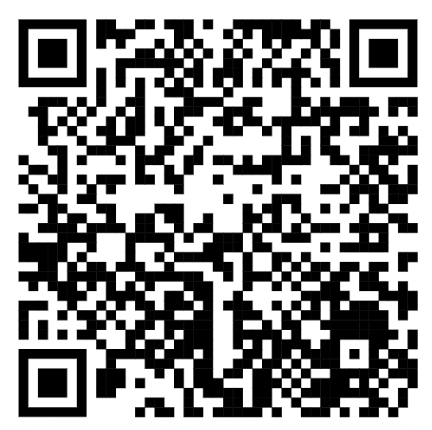

Project Description
Pre-Workshop Survey
We are using LEGO Spike Sets to build a simple launcher, which will be programmed and utilized in engaging carnival-style games.
This hands-on project allows participants to interact directly with the technology while learning core coding concepts.
Teaching focus: Our main educational objective is to teach fundamental programming concepts, specifically variables, conditionals, and loops, in a practical and approachable way.
Notes:
Jenna

Slide 5
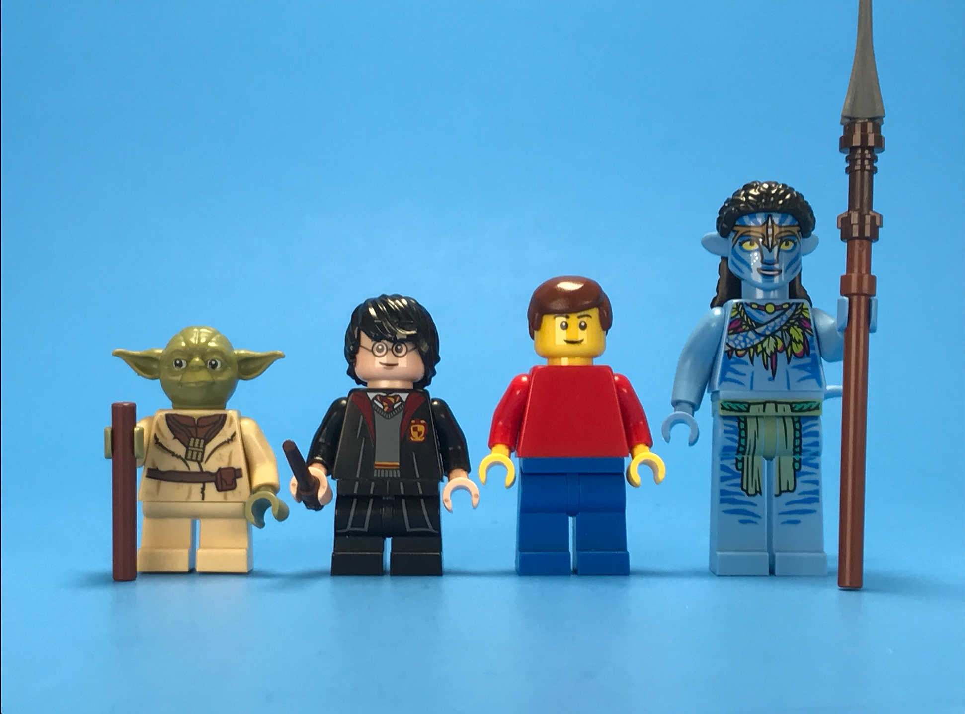

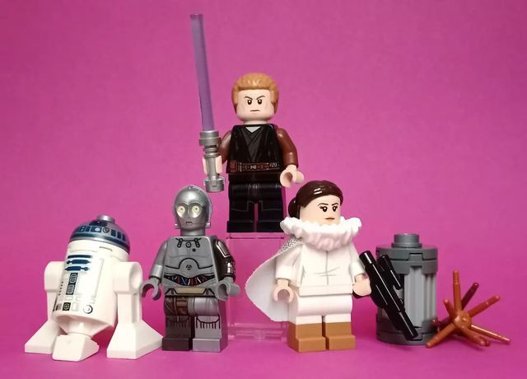
Split into 3 teams!

Slide 6

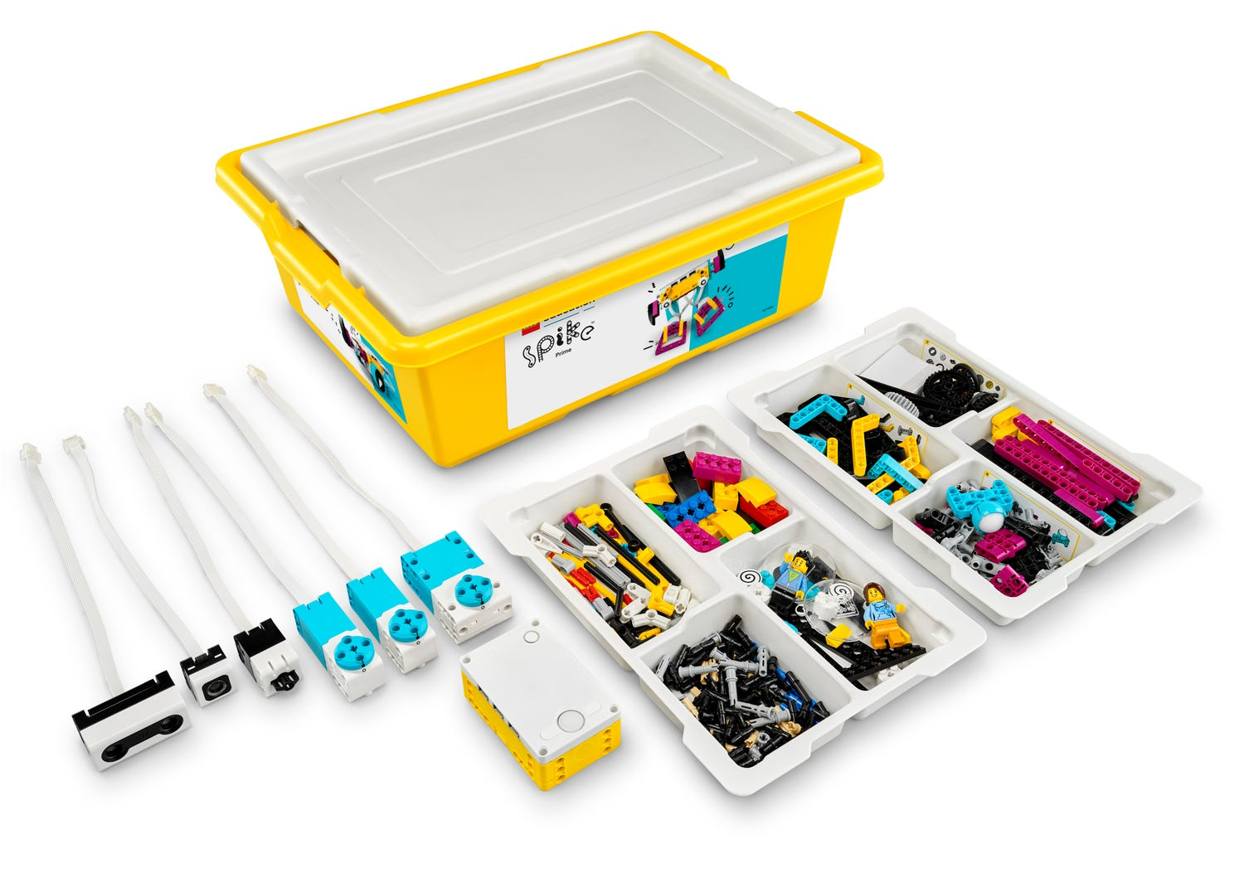
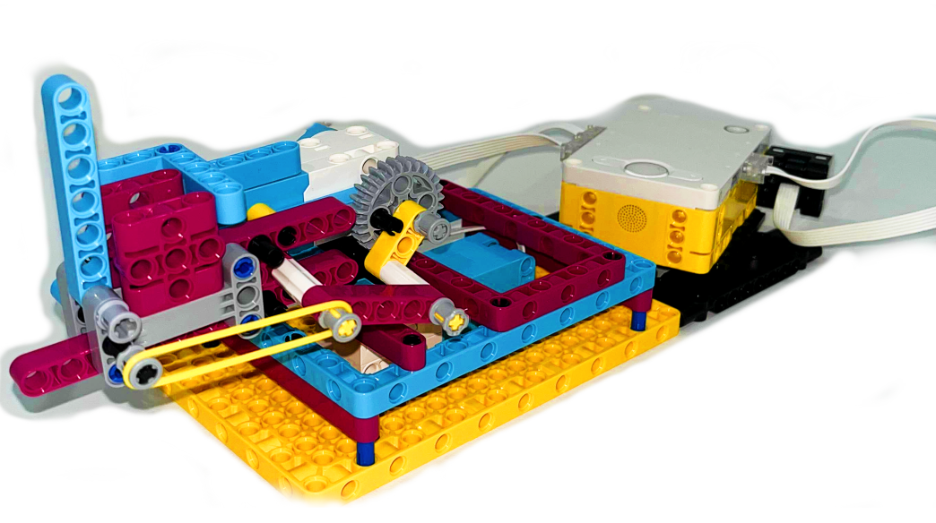
Technology
Technology: LEGO Spike includes programmable motors, sensors, and building components. This is paired with the Spike’s block coding platform, which provide a visual environment for coding, allowing users to drag and drop blocks to control the behavior of the components.
How we’re using the technology: By integrating LEGO Spike Sets, we provide an interactive, active learning environment where participants can immediately see the impact of their code on the launcher’s movements. This visual feedback reinforces understanding and creates an immersive experience that helps achieve our goal of sparking interest in programming.
Notes:
Miguel

Slide 7
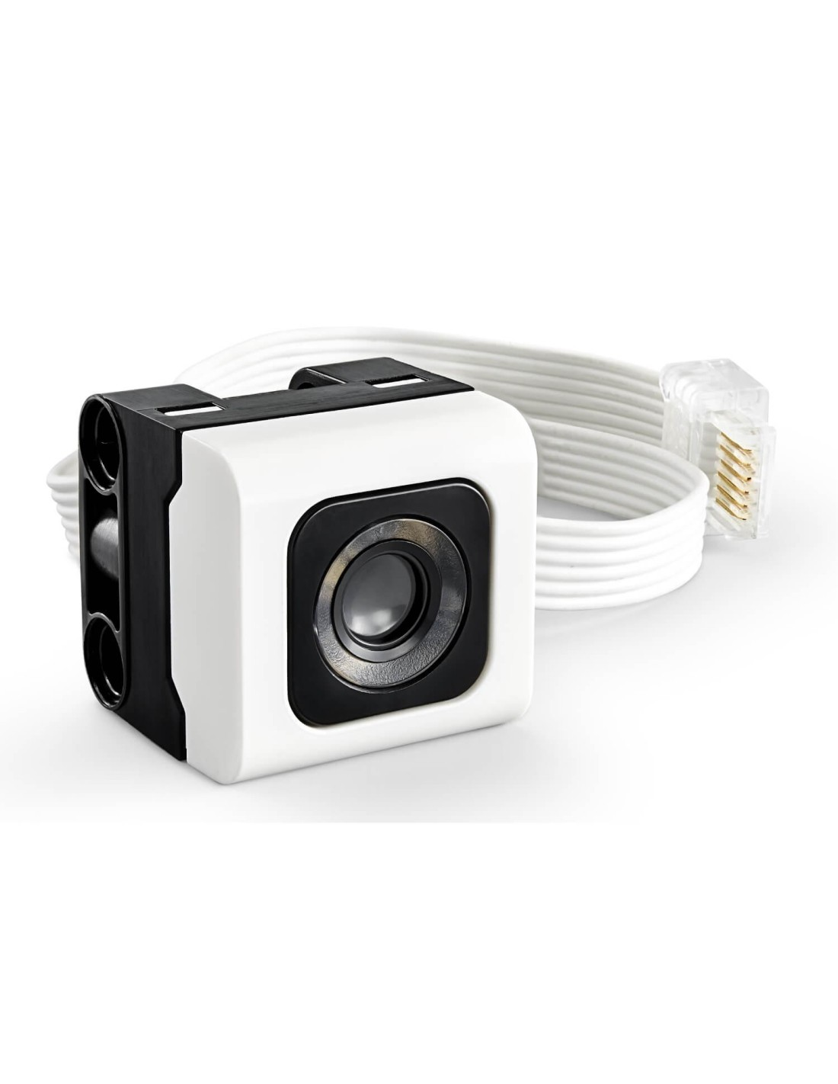
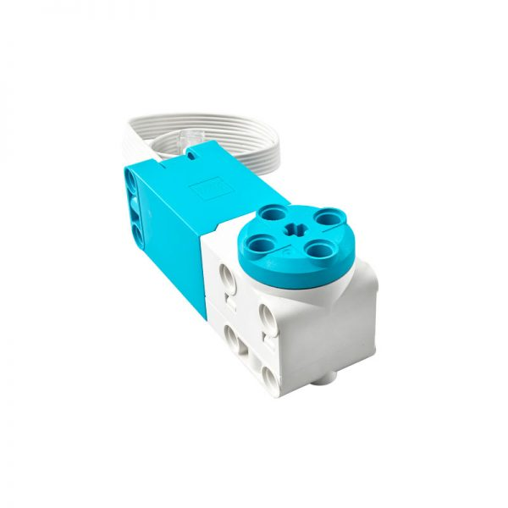
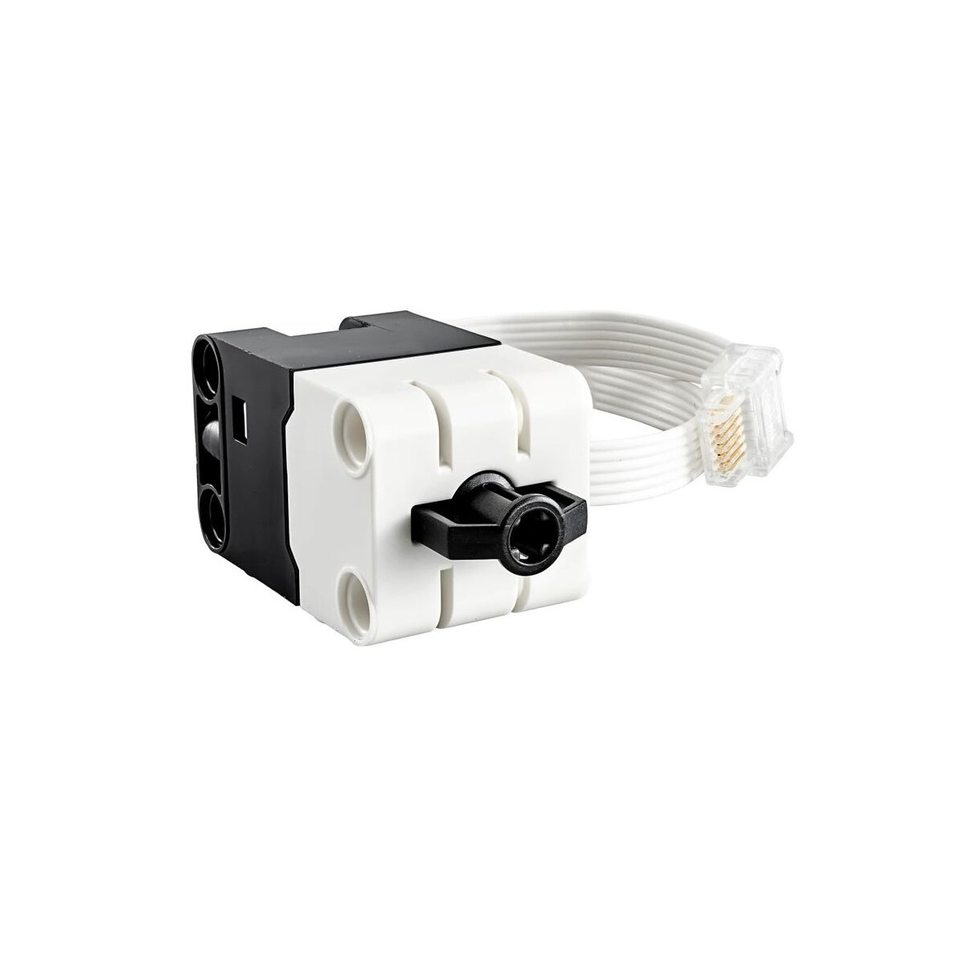
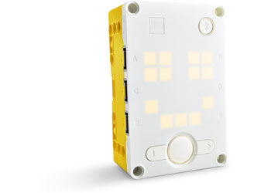
Components we will be using
Pressure Sensor
Motors
Color Sensor
Hub

Slide 8
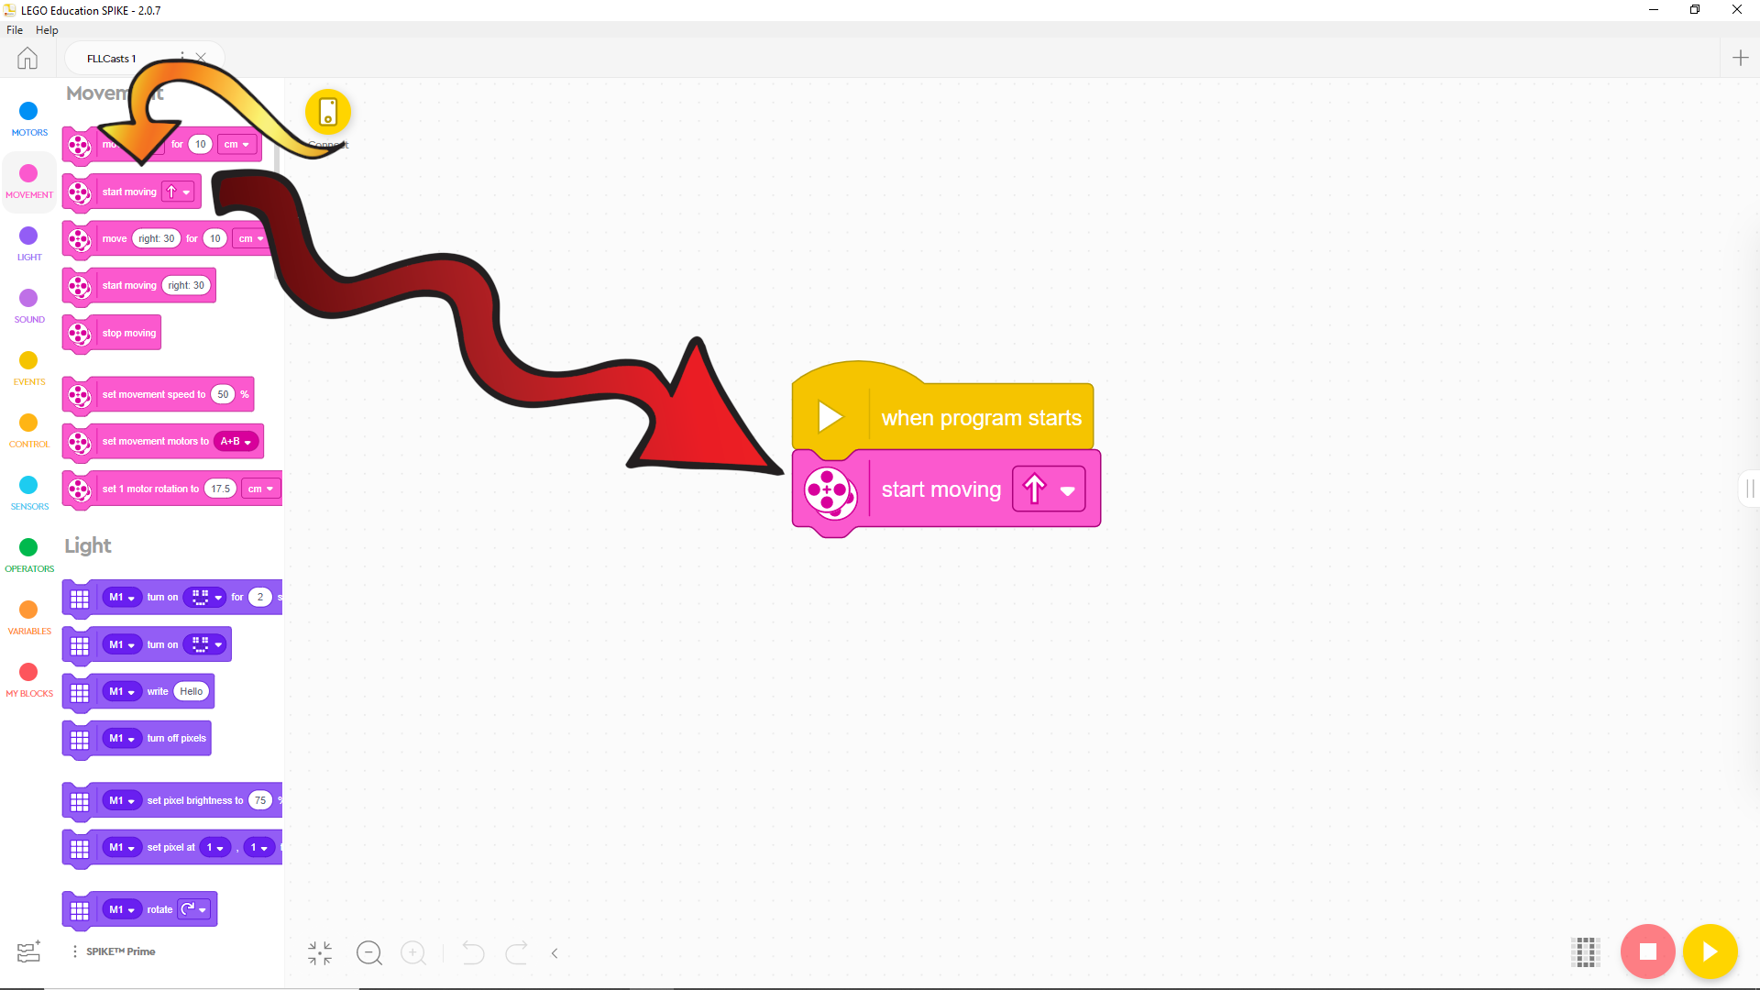
Drag and Drop Word Block Coding:

Slide 9
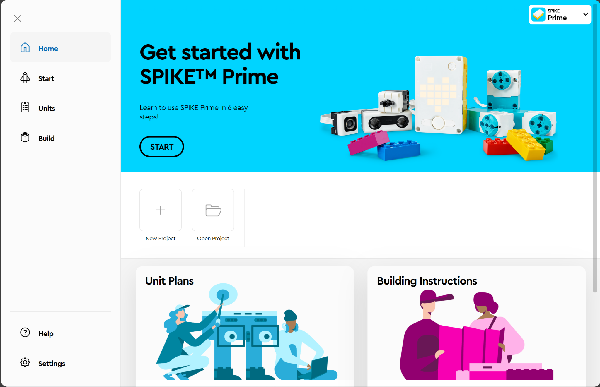
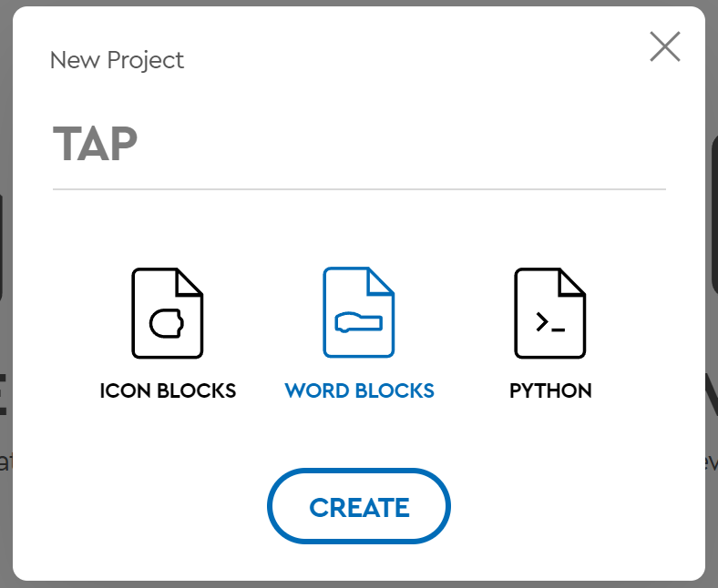
Creating your project
Go to spike.legoeducation.com and select SPIKE Prime (Use Google Chrome)
Select “New Project
3. Name your project whatever you want, make sure word blocks is selected, and click CREATE
Notes:
Jenna

Slide 10
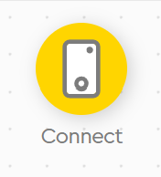
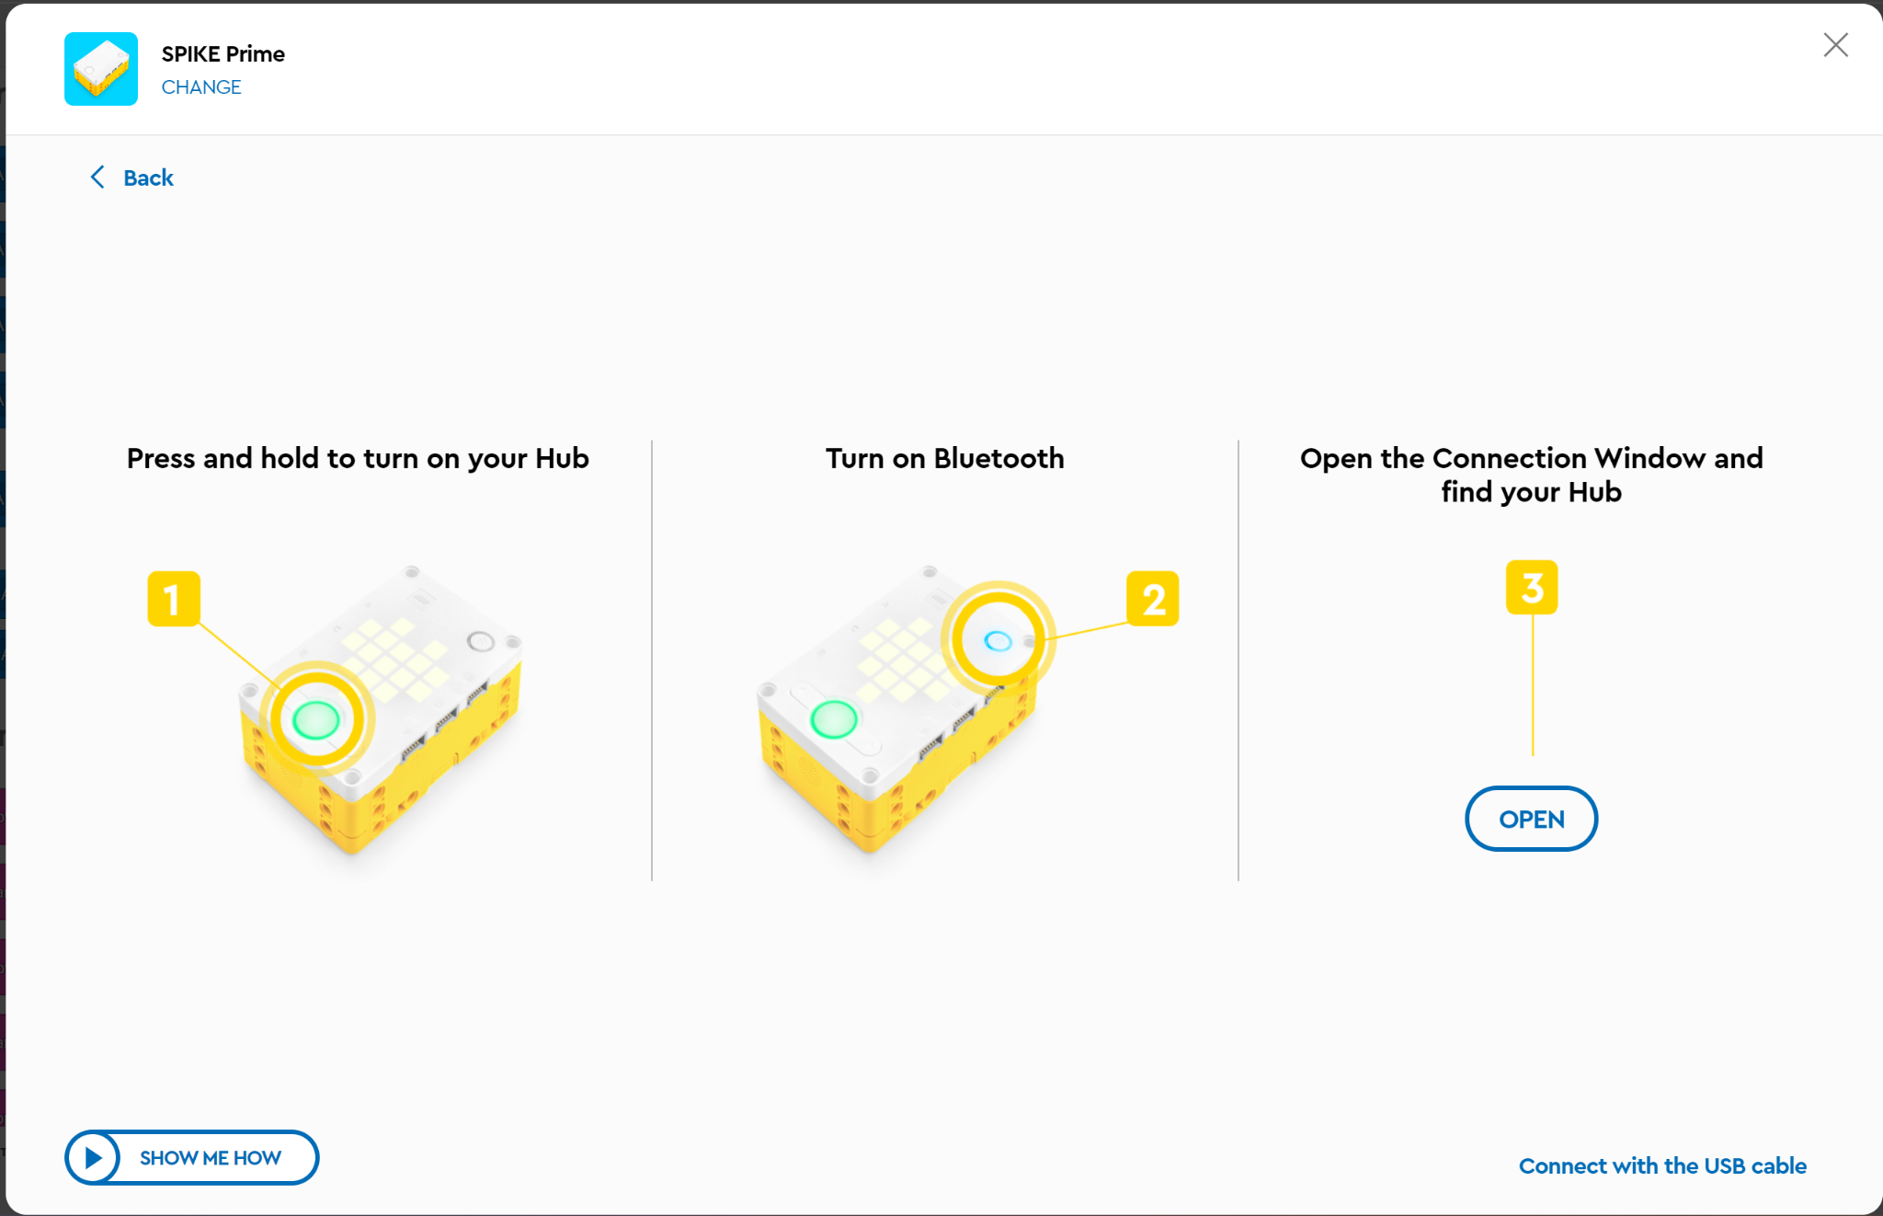
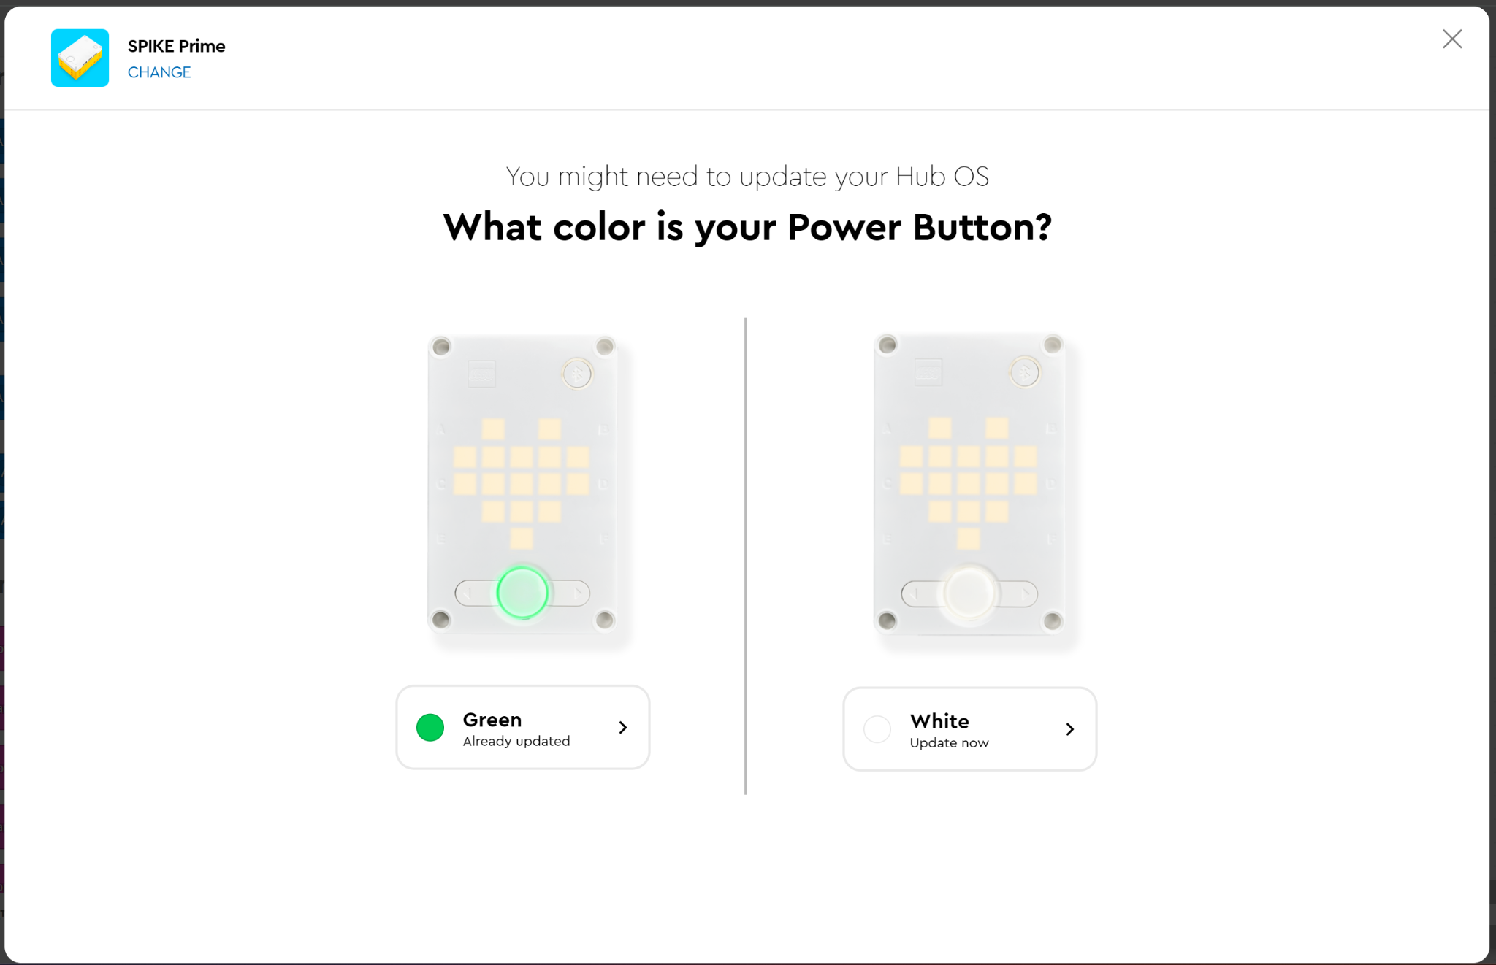
Connecting the Hub to your project
Click the “connect” button in the upper left corner
Select Green
3. Select “connect with USB cable in the bottom right corner
4. Click “open” and select the Hub and press “Connect”
Notes:
Jenna

Slide 11
Part 1
Programming the controller

Slide 12
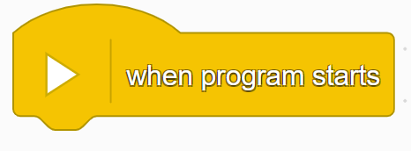
Event Handler
Event handlers are commonly used in many programming languages to define a block of code that runs in response to specific events (like starting the program, pressing a button, or receiving input). In the case of LEGO SPIKE, it signifies the event of starting the program, and all connected code will be executed in order from that point.
"When Program Starts" block is an event handler. It's not a conditional, a variable, or a function by itself. Instead, it represents an event that triggers when the program begins running.

Slide 13
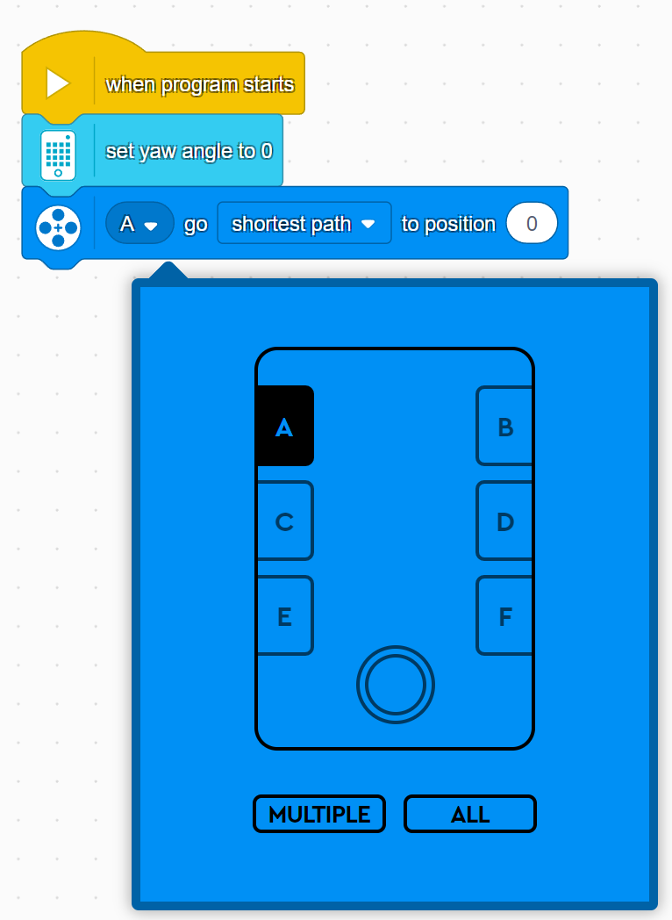
Variables:
A variable in coding is a label for storing data that can change or be used later in a program.
Setting the angle:
"Set Yaw Angle to 0" is an action or command. Specifically, it can be thought of as a function call that resets a particular value (the yaw angle) to zero.
This will face your launcher forward
Setting the motor:
“A” is a variable representing the port on the hub that the motor is plugged into
Select the correct letter based on which port your motor is plugged into

Slide 14
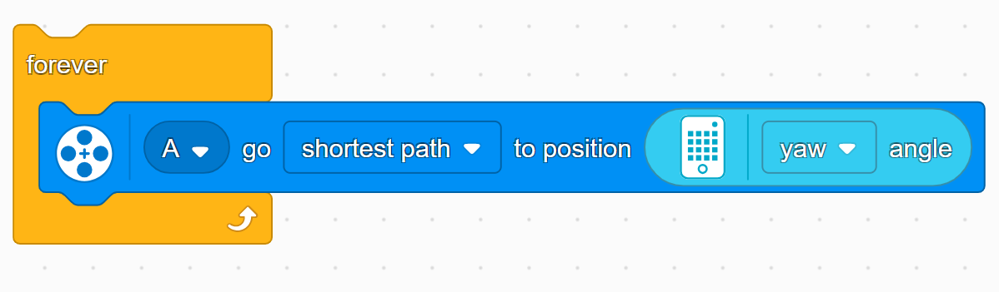
Loops
"Forever" loop is a control block that repeatedly runs the set of instructions inside it indefinitely. Once the program enters the loop, it will keep executing the commands in the loop continuously until the program is stopped manually or another condition interrupts it.
These blocks will forever make the A motor go to the shortest path to the angle the yaw. (yaw refers to the rotation of a device)

Slide 15
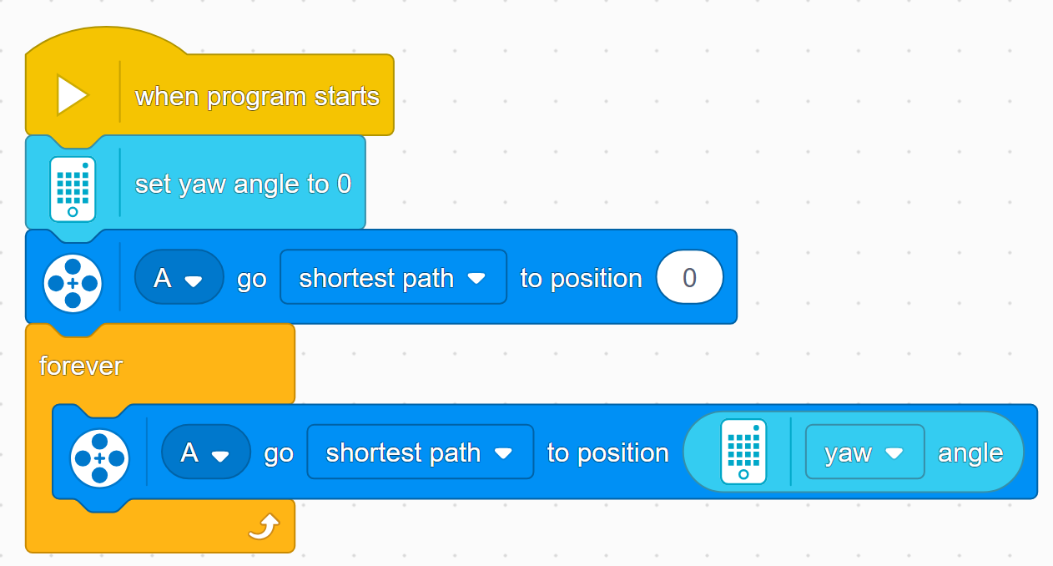
This is the completed code

Slide 16
Part 2
Launching with the press of a button
Notes:
Jenna

Slide 17
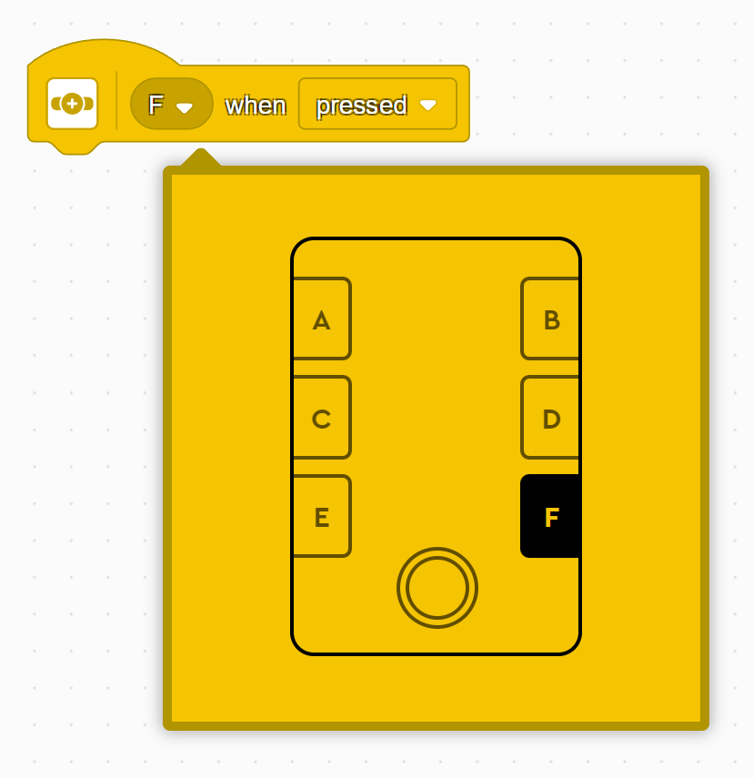
Conditionals
A conditional is a programming statement that runs certain code only if a specific condition is true.
pressed - this is a boolean value (true or false)
When the button is pressed, “pressed” will be true
When the button is not pressed, “pressed” will be false

Slide 18
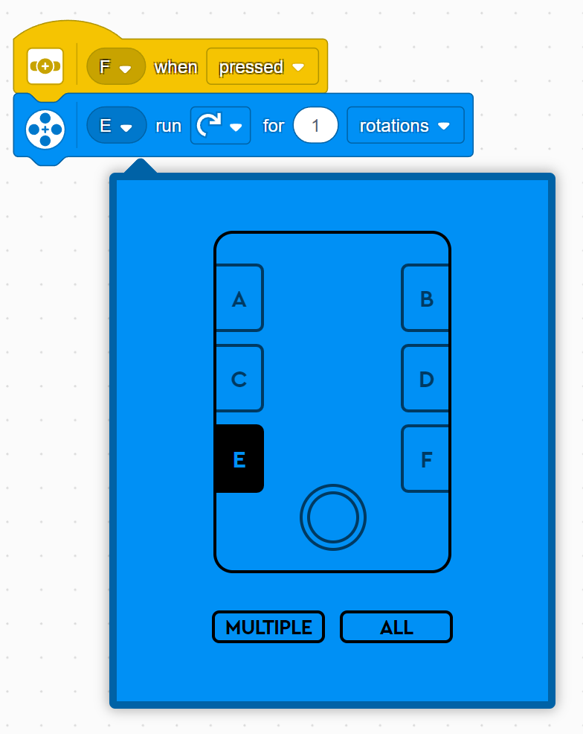
Program the motor
E is another variable, represents the port that the motor is plugged into on the hub
We will have the motor rotate clockwise
We need the motor to run for 1 full rotation
That’s it! Press play and test your code!

Slide 19
Part 3
Code Challenge

Slide 20
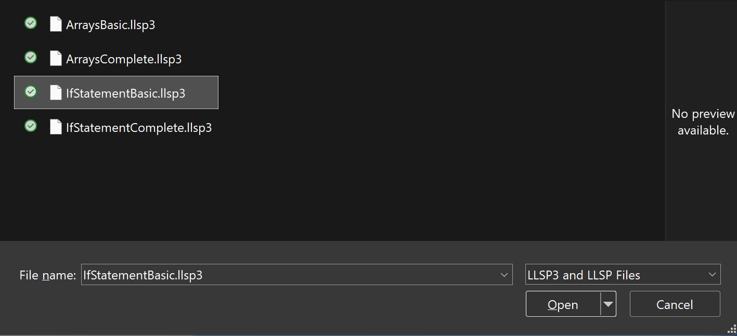
Uploading project
1. Download IfStatementBasic.lls3p
2. Go to spike.legoeducation.com and select SPIKE Prime
3. Select “Open Project”
4. Select the file from your downloads folder and select “Open”
Notes:
Jenna

Slide 21
Connecting the Hub to your project
Click the “connect” button in the upper left corner
Select Green
3. Select “connect with USB cable in the bottom right corner
4. Click “open” and select the Hub and press “Connect”
Notes:
Jenna

Slide 22
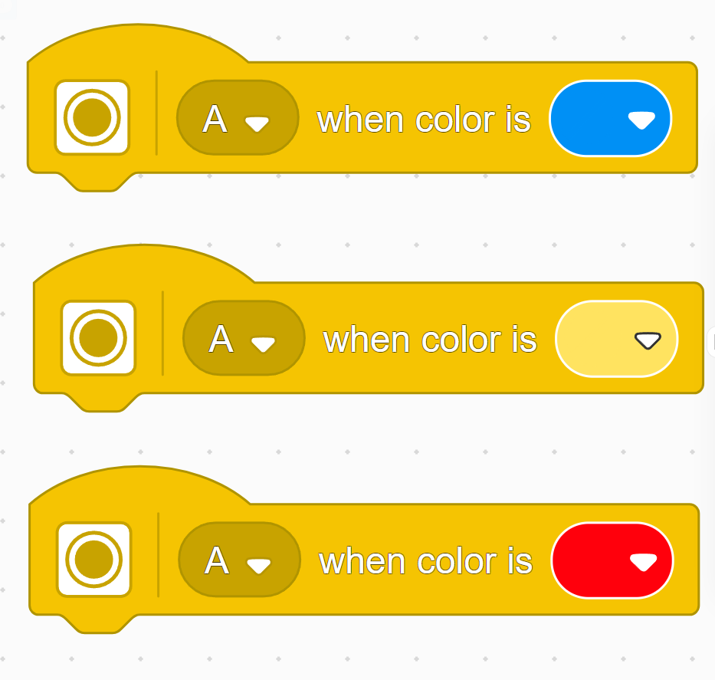

More Conditionals
A conditional is a programming concept that allows a program to make decisions based on whether something is true or not
Examples:
Conditional to check the color of the target

Slide 23
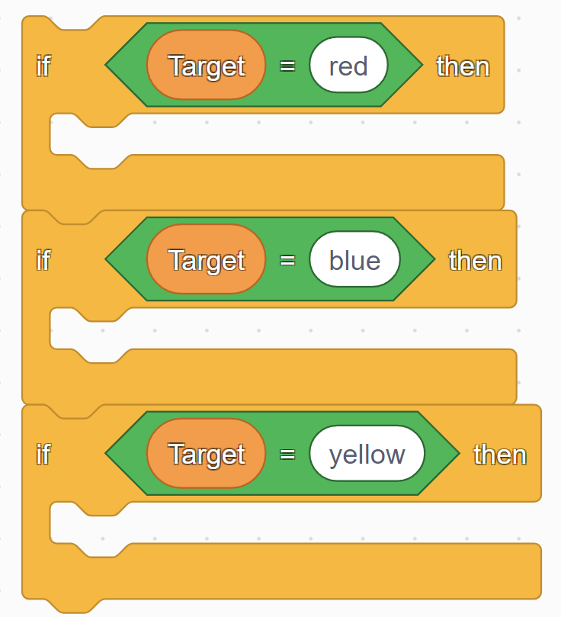
If-Statements
An if-statement is a conditional statement in programming that checks whether a given condition is true or false, and based on that, it executes a specific block of code.
Example:
Check the color of the current target

Slide 24
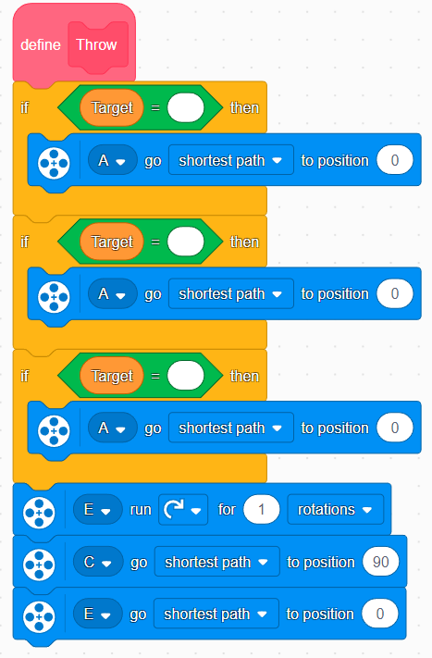
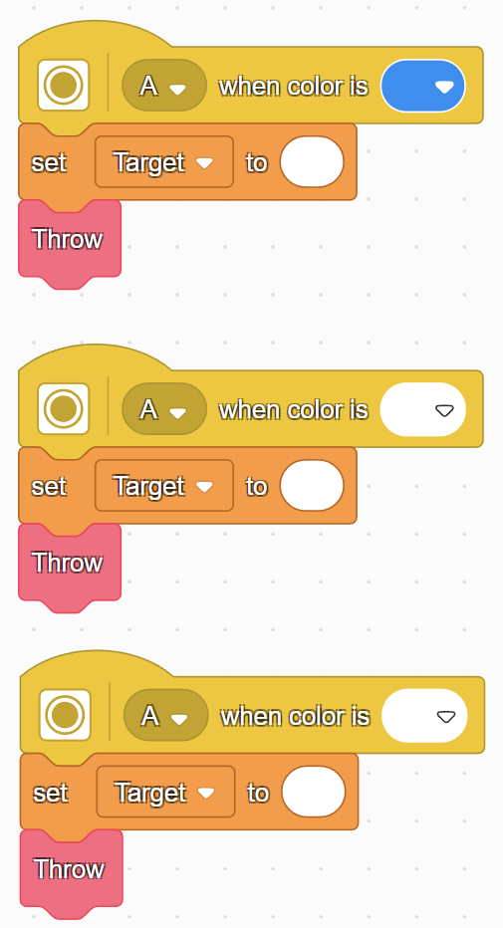
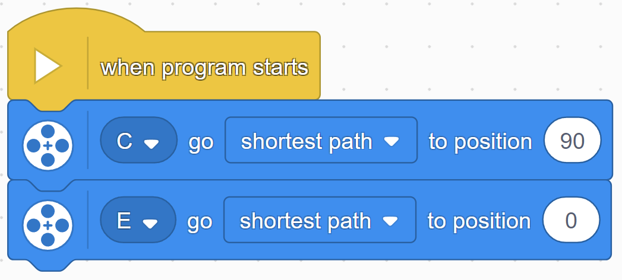
Code Breakdown
Resetting Catapult
Shooting Projectile
Choosing Target

Slide 25
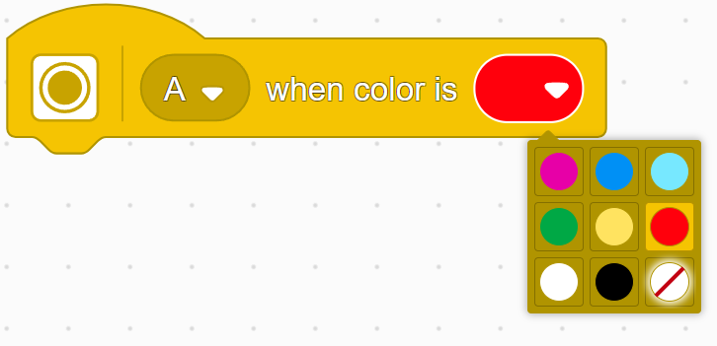
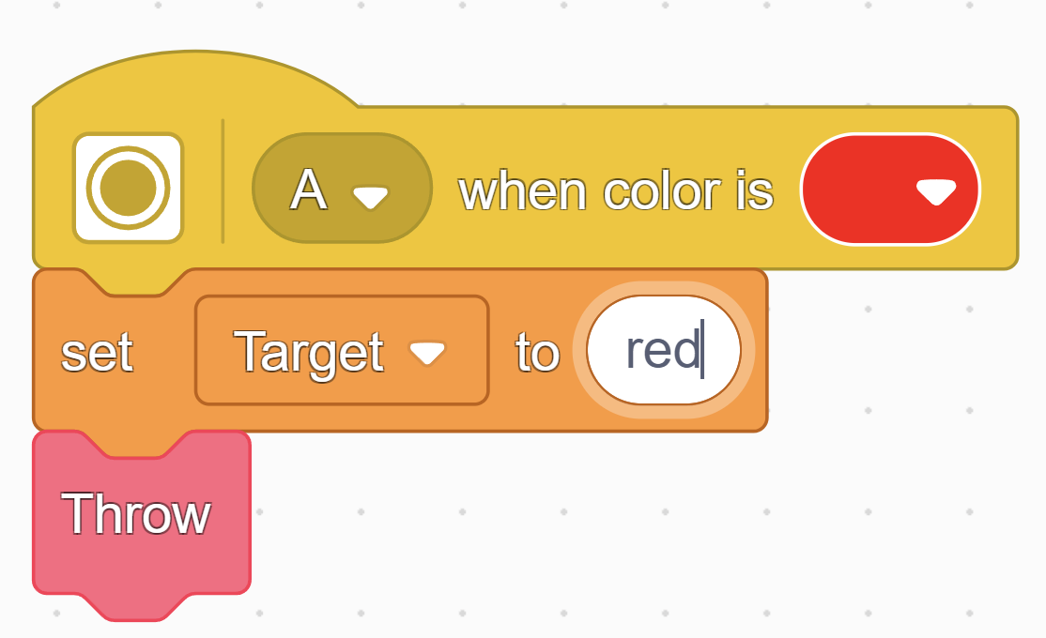
Step 1: Define Our Targets
A uses a light sensor that detects colors
The sensor will detect the color shown and set the current target to that color
Let's define our colors and them to the list!

Slide 26
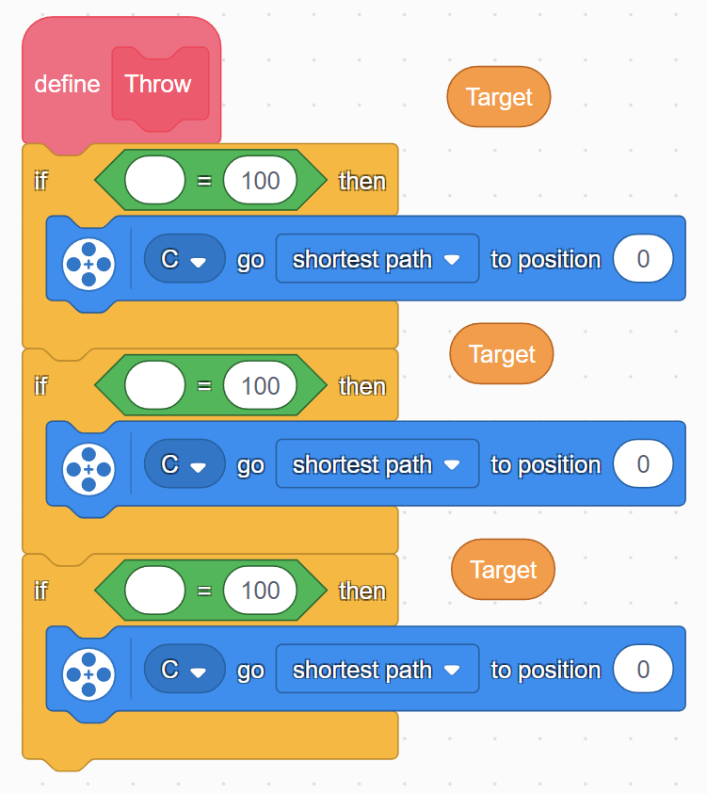
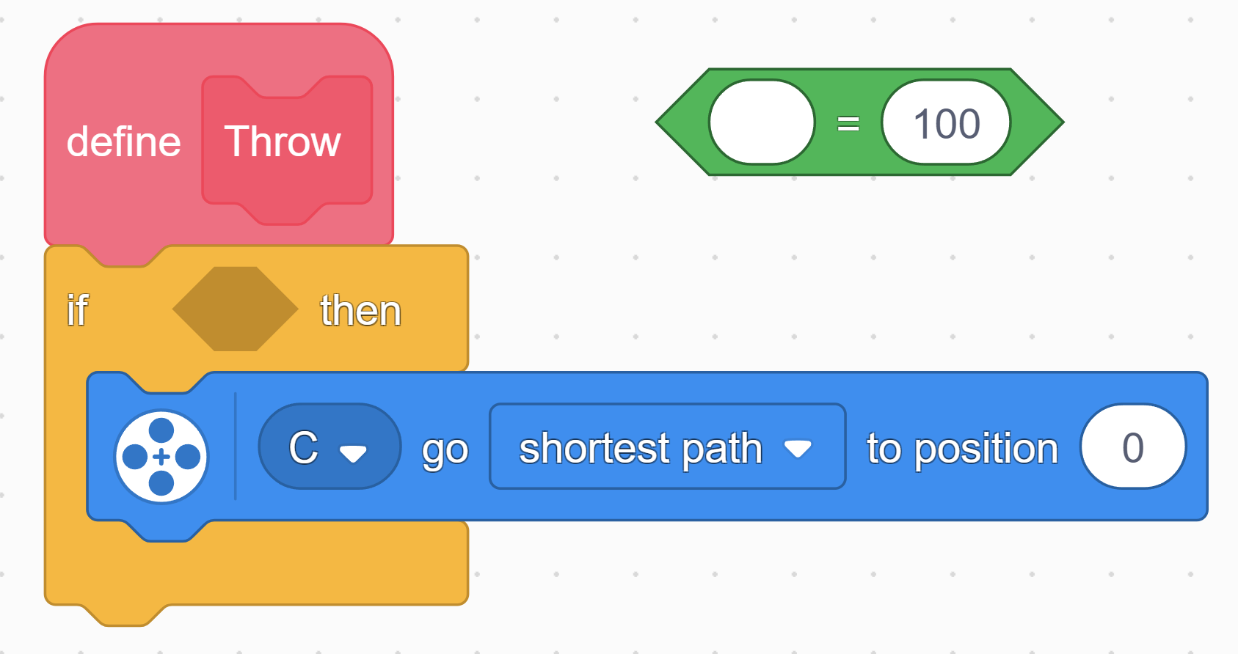
Step 2: Build if-statements
2.
To start building the conditional, we need to drag an “=” block, this is called an operator
Next we need to add our variable to the if statement. This will allow us to check the color value of our target.
1.

Slide 27
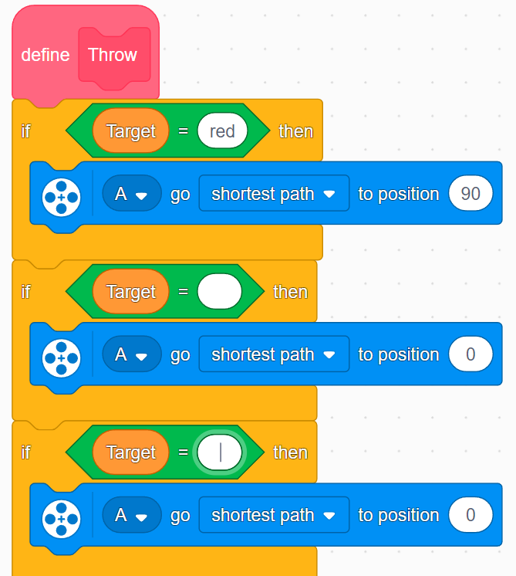
Step 3: Aim At Targets
Now we need to aim the catapult at the right colors.
Using conditionals and if-statements, we can move the motor to aim at the right target depending on the color
Let's add the color of the target to our condition and move the motor to the right angle. Type the same color from the last step!
0°
30°
330°

Slide 28
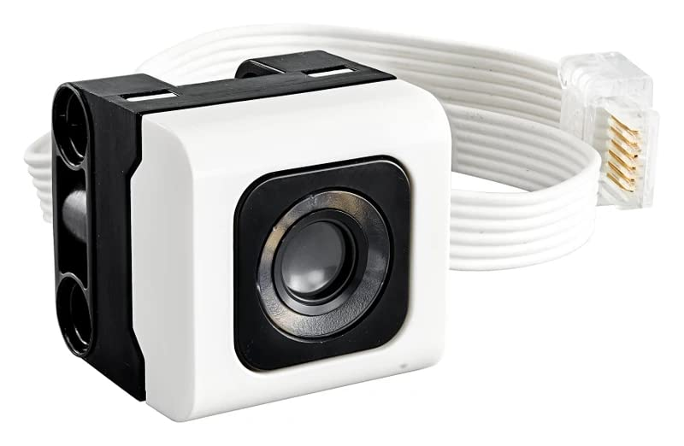



Step 4: Test the Catapult!
Show color blocks to the sensor
Switch it up! Try different sequences

Slide 29
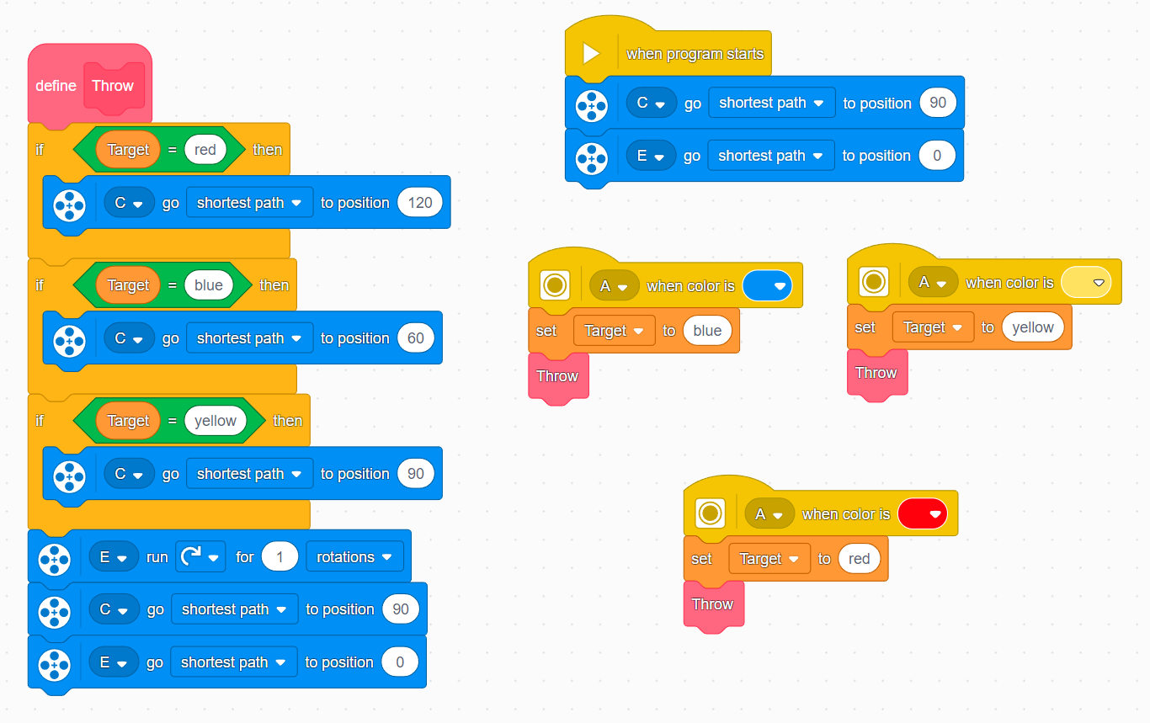
Completed code

Slide 30

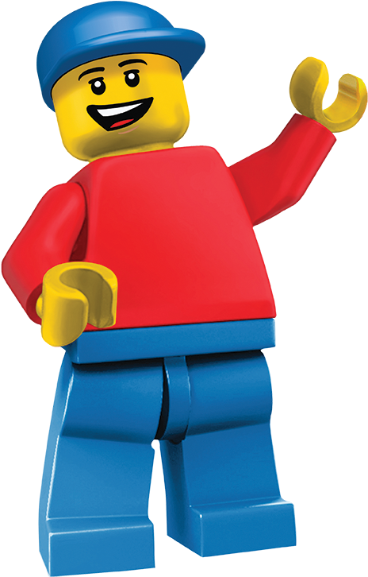
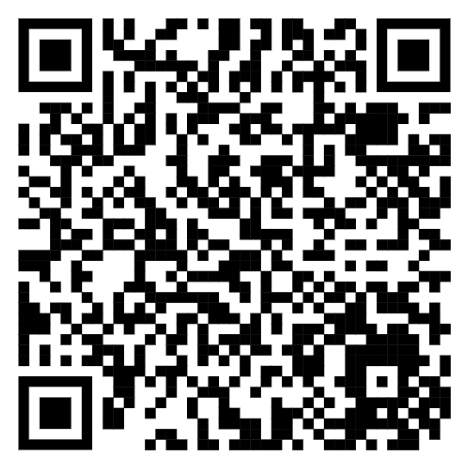
Post-Workshop Survey:

Slide 31

Thank you!
Questions?

